Slide 1
Partial regressions
蒋智超
2025年 秋

Slide 2
Motivation
We have the basic inference procedure for the coefficients
Other results require a more detailed understanding of the properties the OLS estimates
Frisch-Waugh-Lovell (FWL) Theorem
Connects simple linear regression with multiple linear regression
ANOVA for linear regression
Model checking

Slide 3
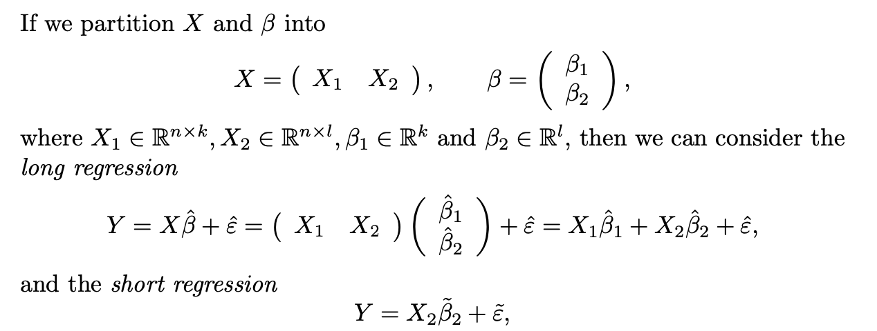
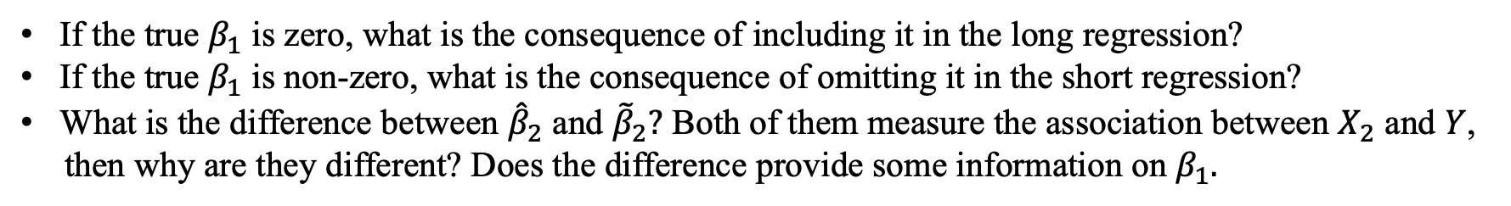
Long and short regressions
If the true $β_{1}$ is zero, what is the consequence of including it in the long regression?
If the true $β_{1}$ is non-zero, what is the consequence of omitting it in the short regression?
What is the difference between ${\hat{β}}_{2}$ and ${\tilde{β}}_{2}?$ Both of them measure the association between $X_{2}$ and $Y$,
then why are they different? Does the difference provide some information on $β_{1}.$

Slide 4
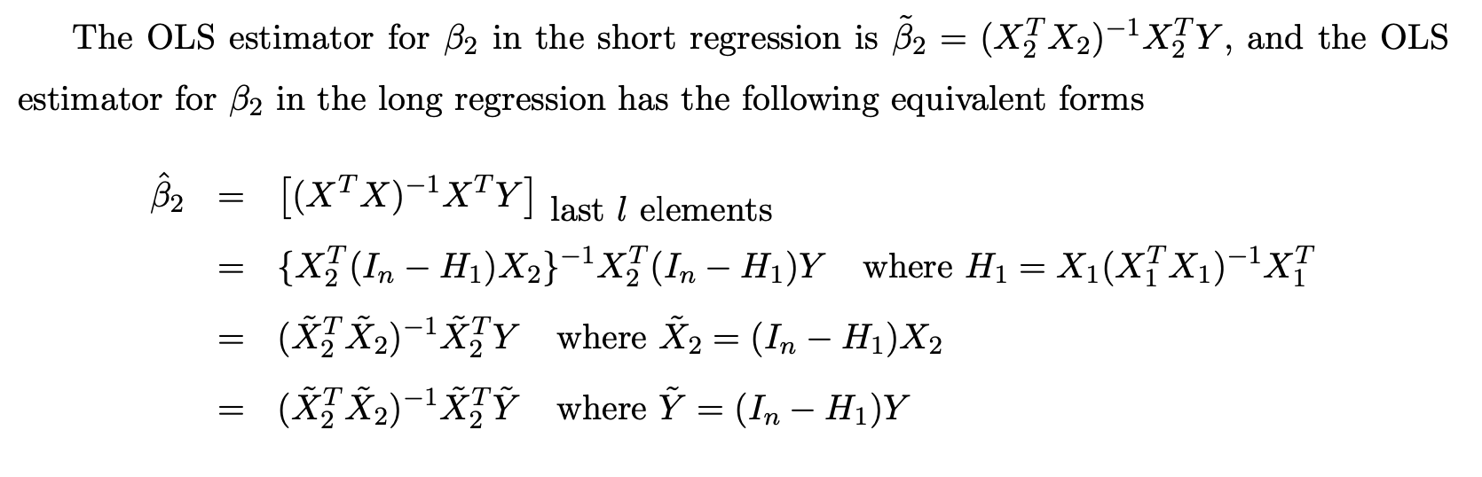
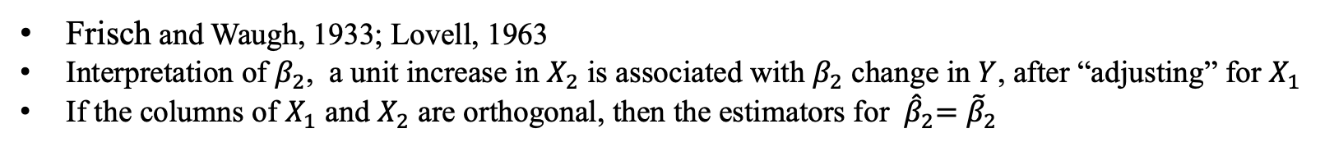
Frisch-Waugh-Lovell (FWL) theorem
Frisch and Waugh, 1933; Lovell, 1963
Interpretation of $β_{2}$, a unit increase in $X_{2}$ is associated with $β_{2}$ change in $Y$, after “adjusting” for $X_{1}$
If the columns of $X_{1}$ and $X_{2}$ are orthogonal, then the estimators for ${ \hat{β}}_{2}={\tilde{β}}_{2}$
Notes:
In econometrics, the “impact” of X2 on Y ceteris paribus. The English meaning of this Latin phrase is “with other conditions remaining the same.”

Slide 5
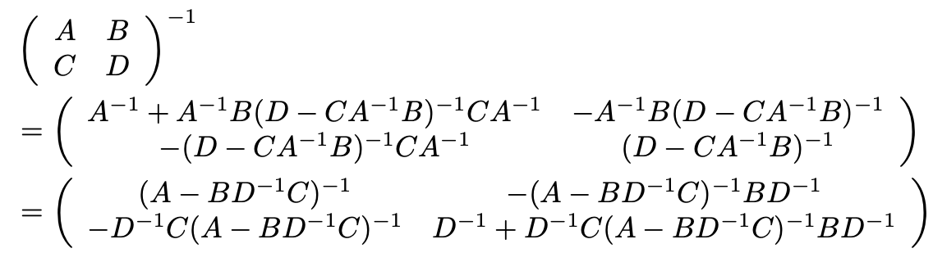
Inverse of block matrix
Implications:
Woodbury formula
Sherman-Morrison formula

Slide 6
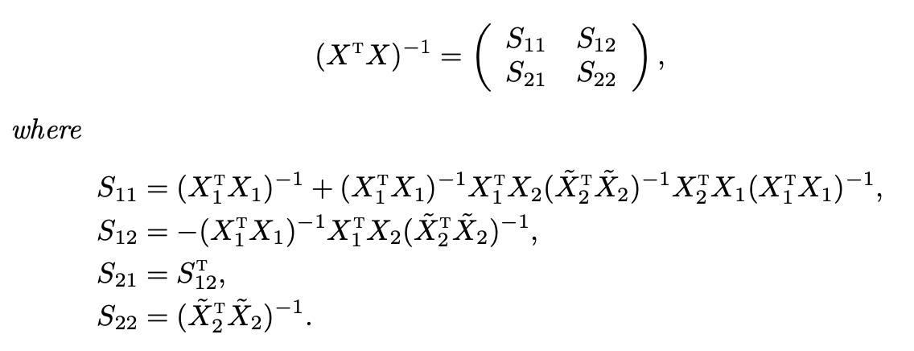

Inverse of $X^{T}X$

Slide 7
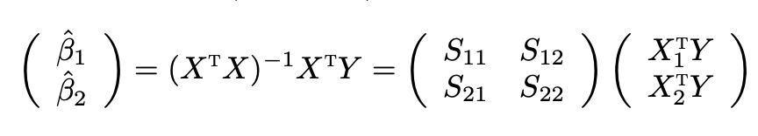
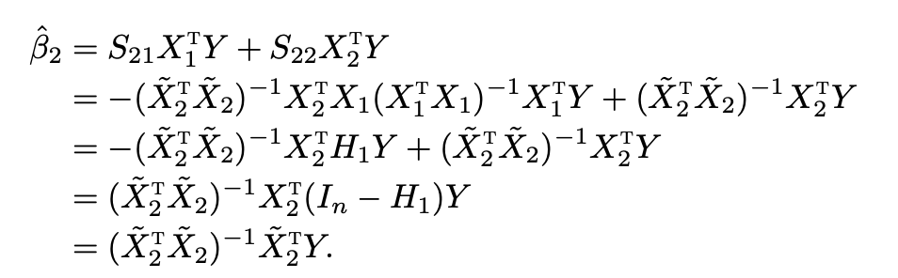
Proof of FWL theorem (version 1)

Slide 8

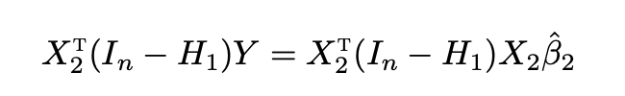
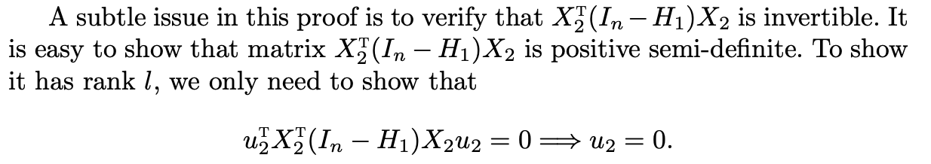
Proof of FWL theorem (version 2)

Slide 9


Decomposition of projection matrix
where
Notes:
The projection of v onto the column space of X equals the summation of the projection of v onto the column space of X1 and the projection of v onto the column space of \tilde X2.

Slide 10
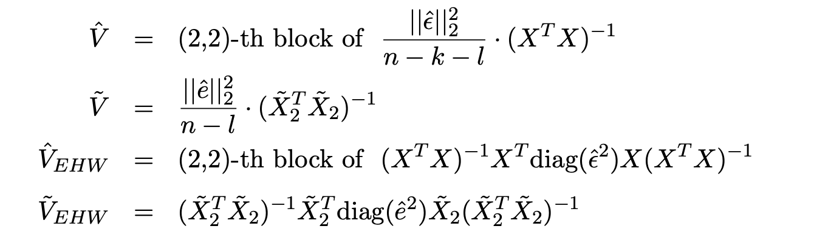

FWL theorem for standard errors

Slide 11

多选题
1分
Which of the following statements are correct?
A
FWL Theorem is purely algebraic
B
FWL Theorem requires Gauss Markov model
C
FWL Theorem requires Normal linear model
D
FWL Theorem requires heteroskedastic linear model
提交

Slide 12
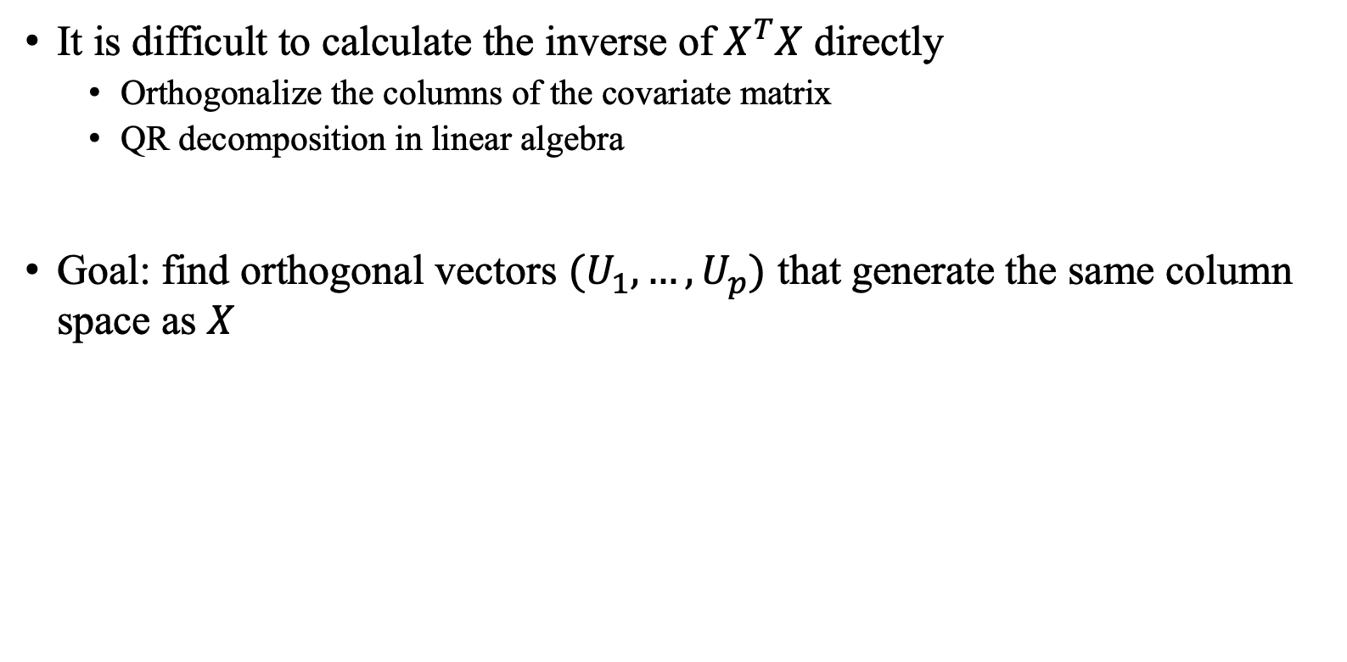
Gram-Schmidt orthogonalization and QR decomposition
It is difficult to calculate the inverse of $X^{T}X$ directly
Orthogonalize the columns of the covariate matrix
QR decomposition in linear algebra
Goal: find orthogonal vectors $(U_{1},…,U_{p})$ that generate the same column space as $X$

Slide 13

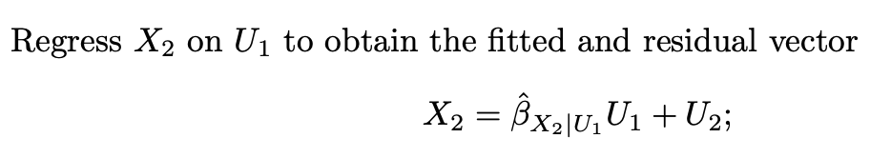

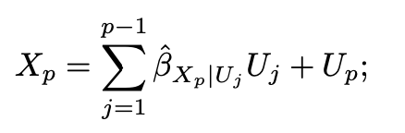


Gram-Schmidt orthogonalization
Normalize U vectors to have unit length
Gram-Schmidt orthogonalization: sequential OLS fits

Slide 14
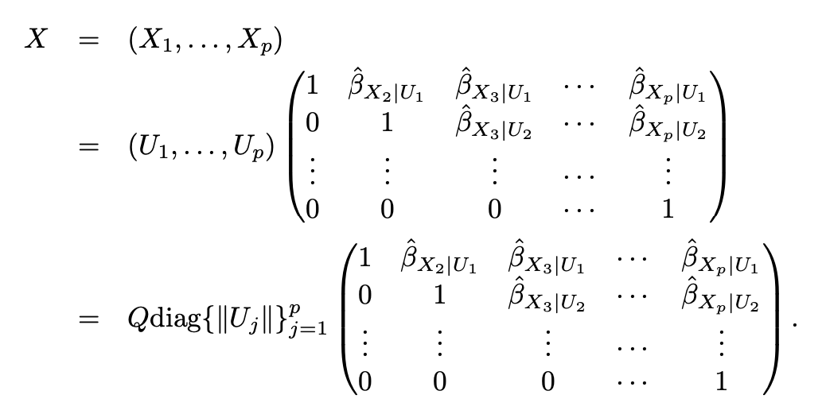
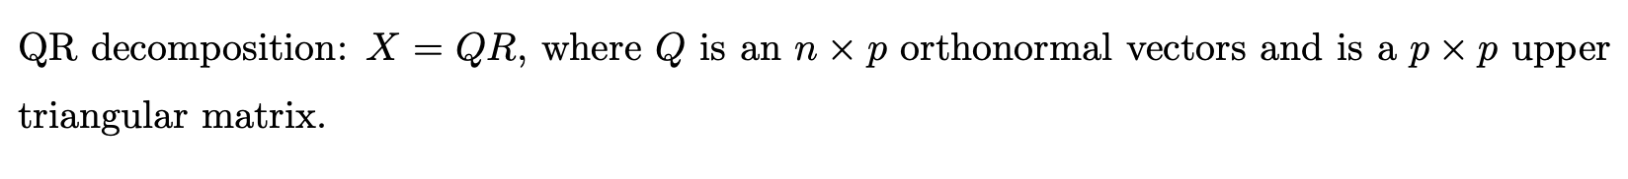
QR decomposition

Slide 15
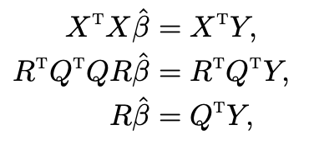
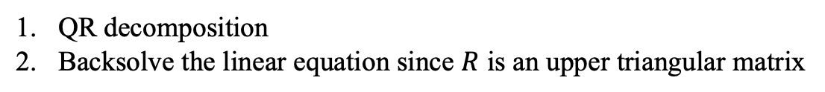
OLS computation
QR decomposition
Backsolve the linear equation since $R$ is an upper triangular matrix
In R, qr function gives the QR decomposition of a matrix. We can specify qr=TRUE in lm function to obtain the QR decomposition of the covariate matrix

Slide 16
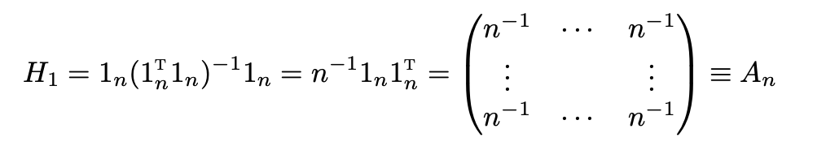

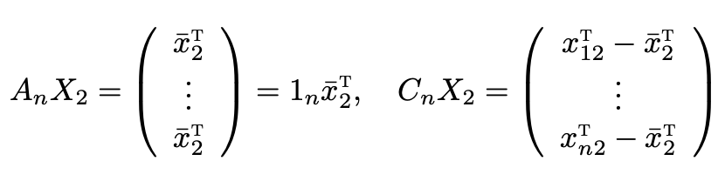

Centering regressors
Partition the covariate matrix into $X=\left(X_{1},X_{2}\right)$ with $X_{1}=1_{n}$
T

Slide 17
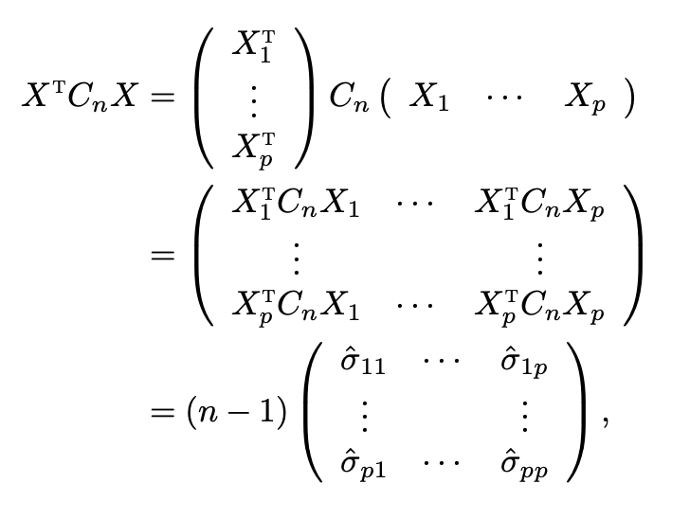
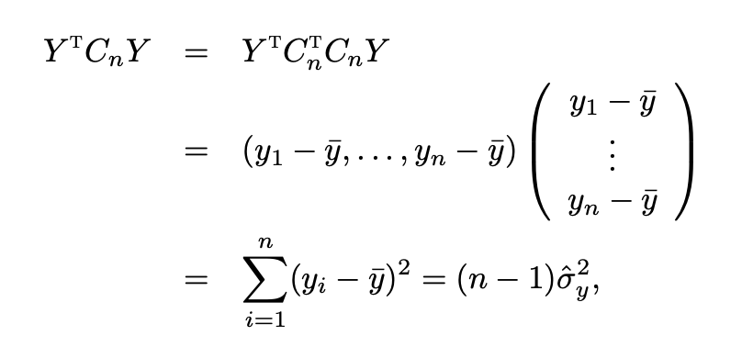

Centering regressors
FWL theorem implies that the coefficient of $X_{2}$ in the OLS fit of $Y$ on $\left(1_{n},X_{2}\right)$ is equal to the coefficient of $C_{n}X_{2}$ in the OLS fit of $C_{n}Y$ on $C_{n}X_{2}$
If each column of the design matrix is centered, then it does not matter to include $1_{n}$ in the OLS
T

Slide 18
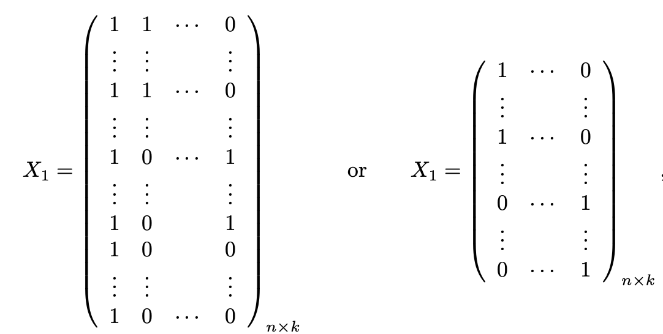

Centering regressors
Partition the covariate matrix into $X=\left(X_{1},X_{2}\right)$
T

Slide 19
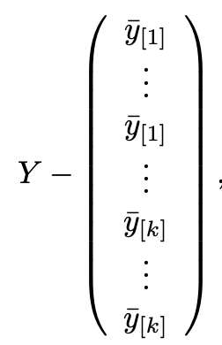


Centering regressors
If we regress$Y$on $X_{1}$, we obtain the residual vector
If we regress $X_{2}$ on $X_{1}$, we center each column of $X_{2}$ by the group-specific means, denoted by $X_{2}^{C}$
FWL theorem: OLS coefficient of $X_{2}$ in the long regression is the OLS coefficient of $X_{2}^{C}$ in the partial regression of $Y^{C}$ on $X_{2}^{C}$
$Y^{C}$=

Slide 20
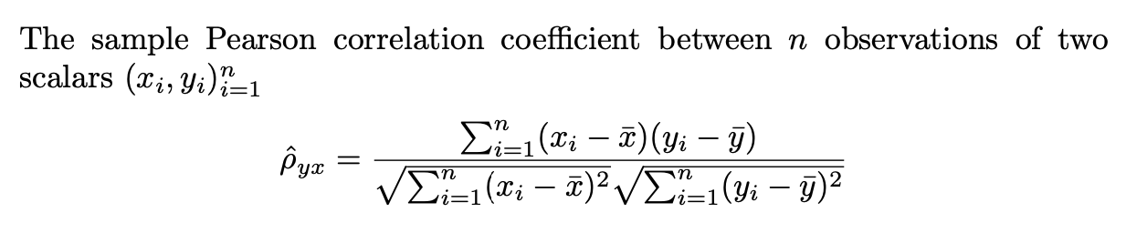

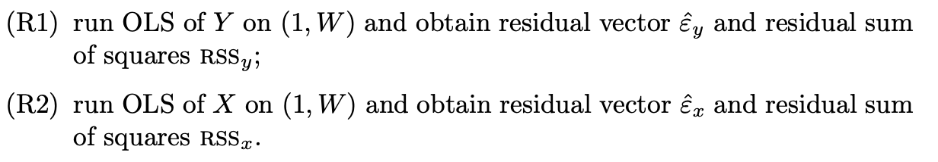
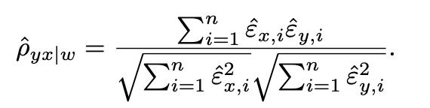
Partial correlation coefficient
How do we measure the relationship between $X$ and $Y$, after controlling for some other variables W
Notes:
Interpretation of the coefficients

Slide 21
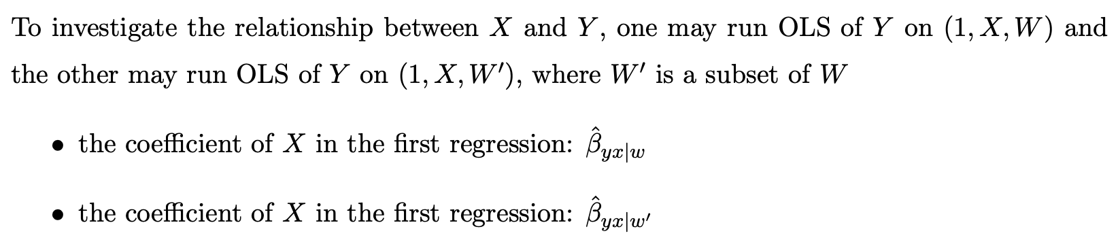

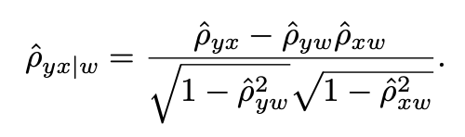

Simpson’s paradox
Simpson’s paradox
Relationship between partial and
marginal correlation coefficient
Simpson’s paradox happens iff
Notes:
Homework: prove relationship between partial correlation and marginal correlation

Slide 22
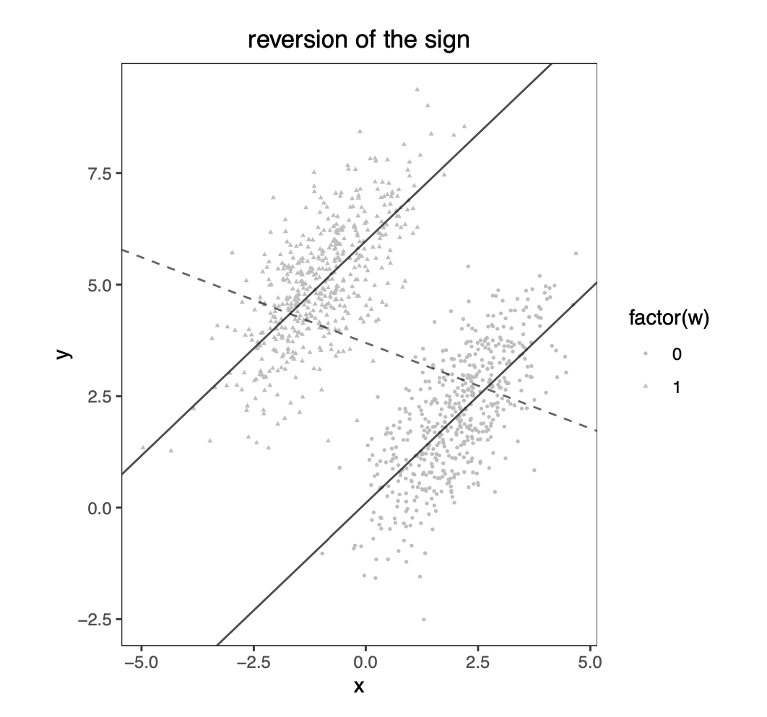
Simpson’s paradox: example

Slide 23
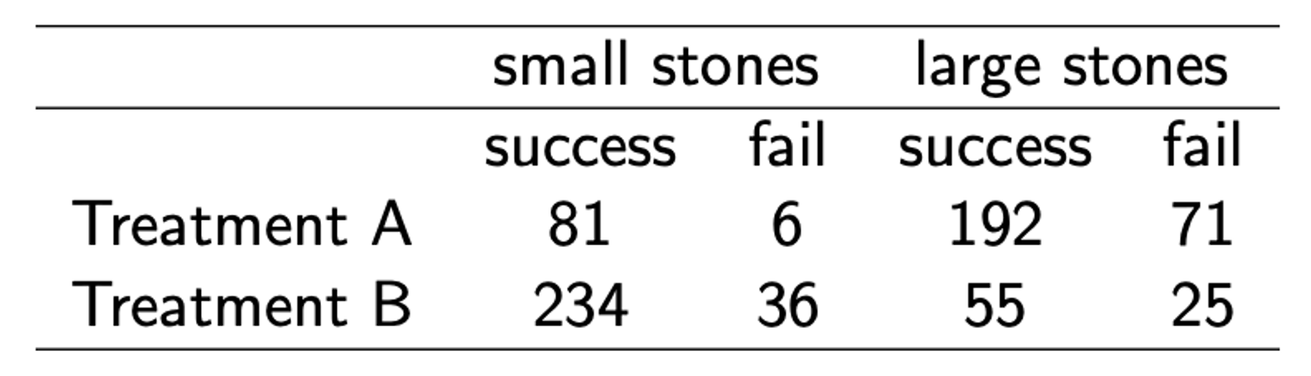
多选题
1分
A
For small stones, A has a higher success rate
B
For large stones, A has a higher success rate
C
A has a overall higher success rate
D
A is more effective than B
提交

Slide 24
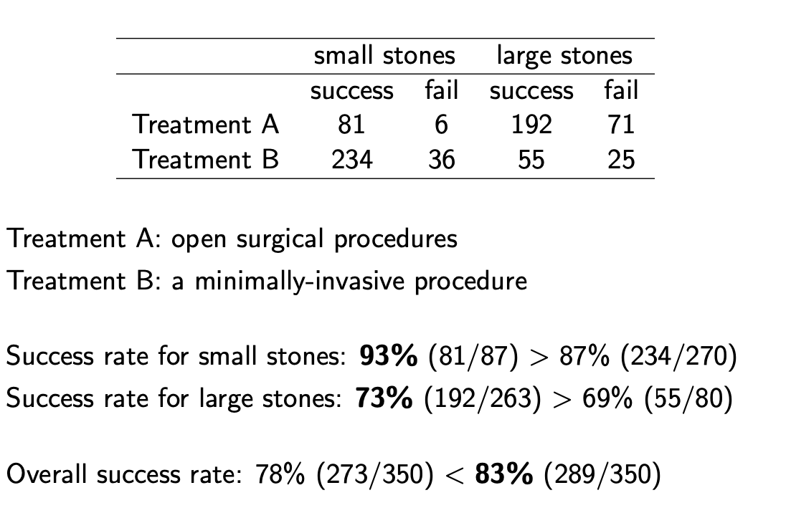
Simpson’s paradox: binary version

Slide 25
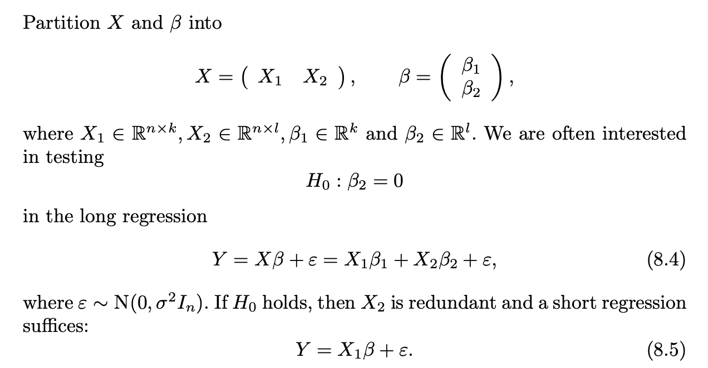
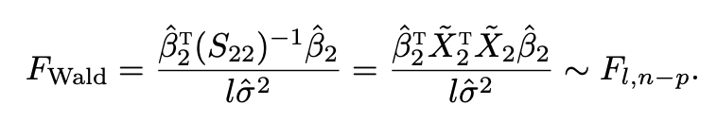
Hypothesis testing

Slide 26
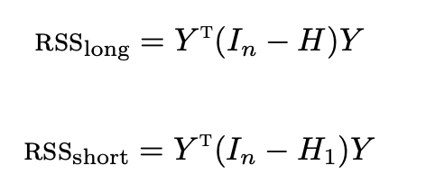
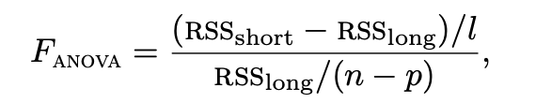


Analysis of variance (ANOVA)
Idea: if $β_{2}=0$, then the residual vectors from the long regression and the short regression should not be too different

Slide 27
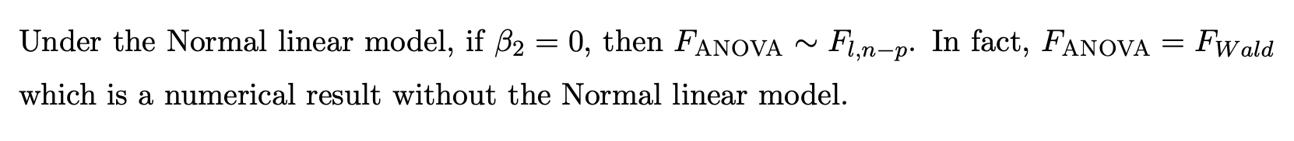
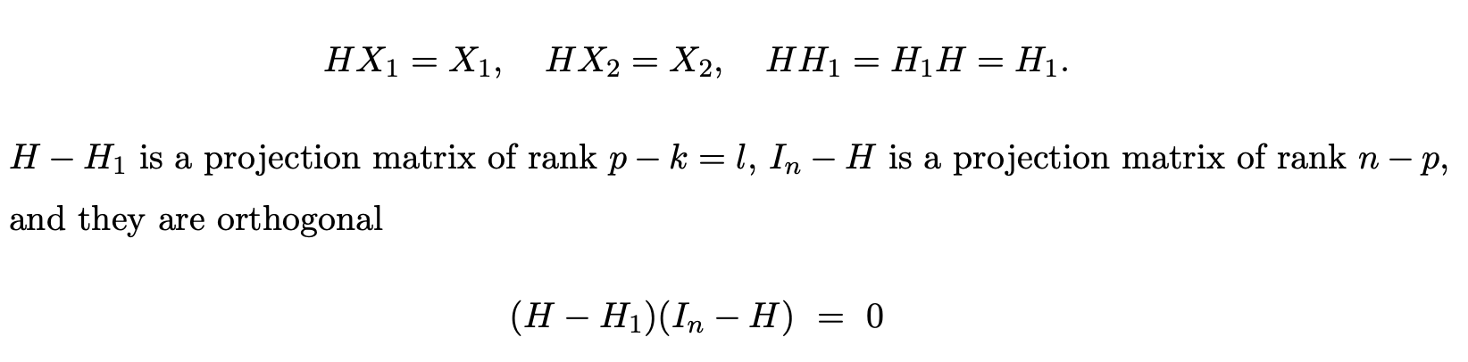
Analysis of variance (ANOVA)
Projection matrix property

Slide 28
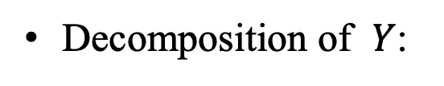
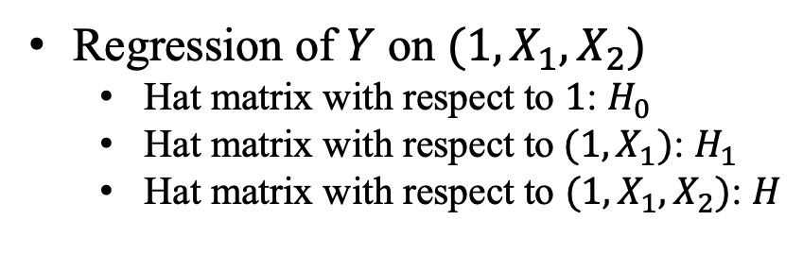
Variance decomposition
Regression of $Y$ on $(1,X_{1},X_{2})$
Hat matrix with respect to $1$: $H_{0}$
Hat matrix with respect to$(1,X_{1})$: $H_{1}$
Hat matrix with respect to $(1,X_{1},X_{2})$: $H$
Decomposition of $Y$:
Decomposition of variances:

Slide 29
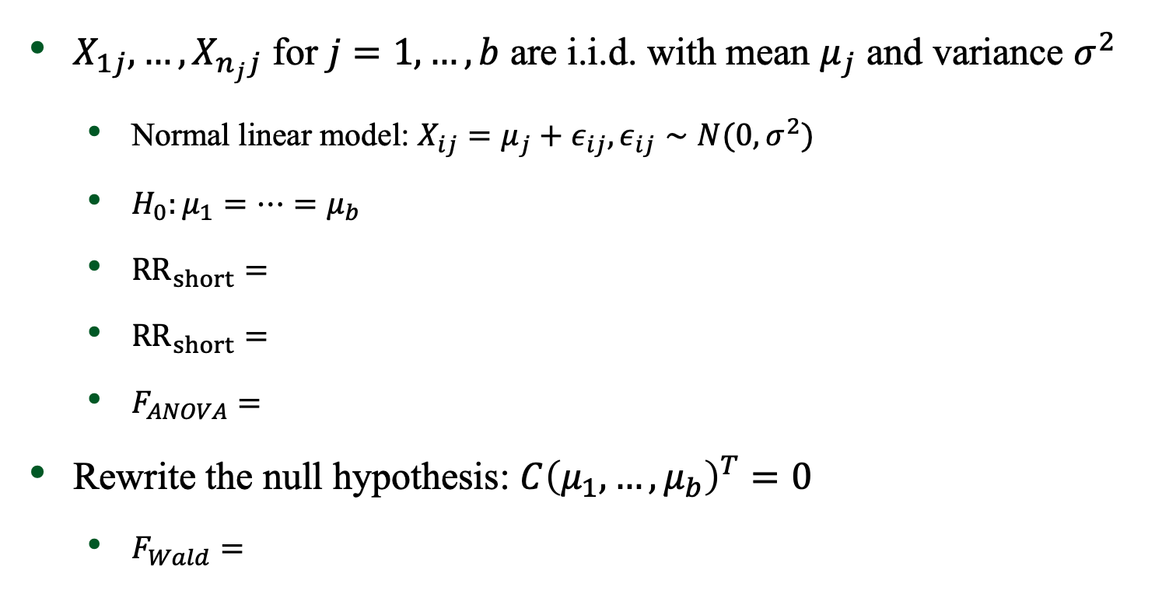
Revisit the one-way ANOVA
$X_{1j},…,X_{n_{j}j}$ for $j=1,…,b$ are i.i.d. with mean $μ_{j}$ and variance $σ^{2}$
Normal linear model: $X_{ij}=μ_{j}+ε_{ij},ε_{ij}∼N(0,σ^{2})$
$H_{0}:μ_{1}=⋯=μ_{b}$
$RR_{short}=$
$RR_{short}=$
$F_{ANOVA}=$
Rewrite the null hypothesis: $C{\left(μ_{1},…,μ_{b}\right)}^{T}=0$
$F_{Wald}=$

Slide 30
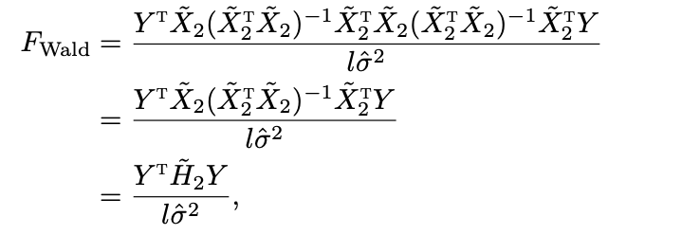
Revisit the one-way ANOVA

Slide 31
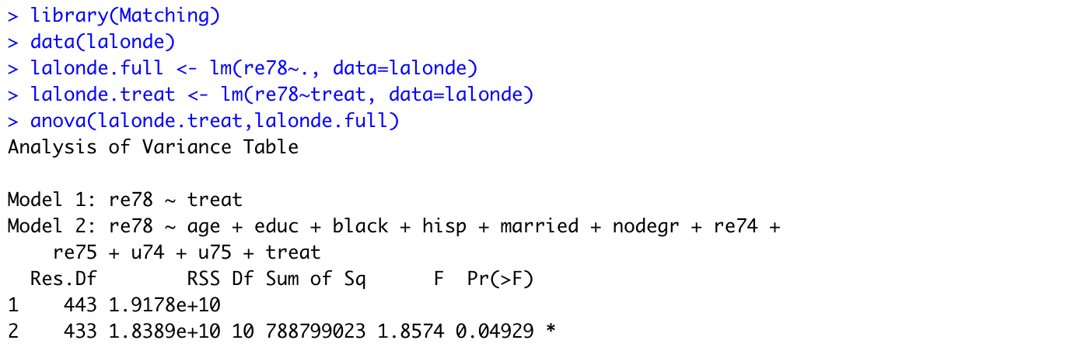
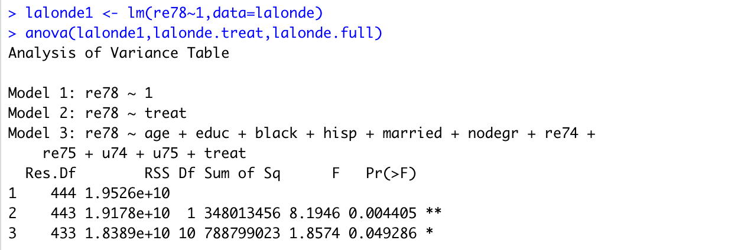
Analysis of variance (ANOVA): example
Notes:
How to test model1 vs model 3

Slide 32
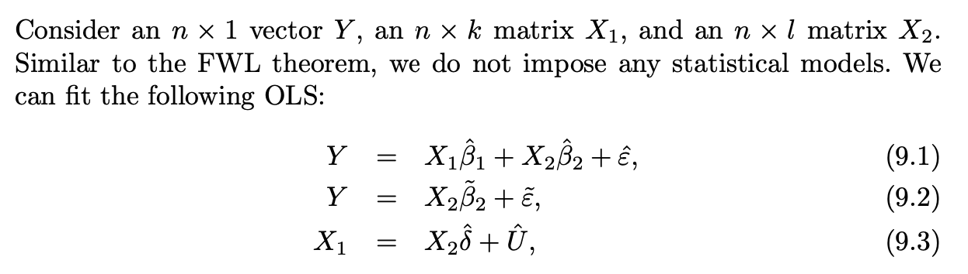


Cochran’s formula
Cochran’s formula
Proof:
Only need to show the last line is the OLS fit of $Y$ on $X_{2}$

Slide 33




Omitted variable bias
Cochran’s formula is called the omitted variable bias formula by econometricians
Quantifies the bias of the OLS coefficient of $X_{2}$ in the short regression omitting
possibly important variables in $X_{1}$
Bias term
Example: estimating causal effects in observational studies
Possible existence of latent confounders $U$

Slide 34



Omitted variable bias
Cochran’s formula:
Confounding bias:
Bias analysis:

